Slide 1
7 Ways To Fix A Bad Attitude & Feel More Positive

Slide 2

Everyone can have a bad day now and then, but there's a difference between being grumpy from a slump and having a bad attitude. A bad day entails things completely out of your control. Maybe you realized you were out of coffee when you woke up extra groggy, and then missed your bus. Maybe you found a hole in your favorite sweater and then got chewed out by your boss at work. Maybe you got stood up for a date or got into a spat with a friend and couldn't but help scowling all the way back to your apartment. bad days happen, and it's completely okay to run away with out feelings now and again and have a good pout.
But a bad attitude? That one's completely in your control. Maybe you find everything to be stressful and terrible at work, or maybe you find a certain relationship grating on your nerves? These are things you can change by just changing your own outlook on. Your bad attitude only escalates the terrible-ness of certain situations and experiences, and that bad feeling can be easily fixed into a good one. Below are seven ways to fix a bad attitude — because the way a situation comes out is completely in your control.

Slide 3

1. Figure Out What Exactly Needs To Be Changed
Before you can change anything, you first need to figure out what's the problem. Did you snap at your friend because you're unhappy at work? Are you feeling in a dark mood because you feel lonely? Are you frazzled at work because you feel unfulfilled? Find the real culprit of your bad attitude.
According to self-development blogger Niro Thambipillay, "There have been many times when I know I’m not quite feeling right but I can’t put a finger on exactly what’s bothering me and until I can figure it out, my attitude remains bad. However, once I figure out exactly what is bothering me, I can then do something about it and my attitude immediately changes." So sit down and iron it out.

Slide 4

2. Find Role Models
It's easier when you're not self-improving alone, so for inspiration and encouragement find role models you want to emulate. And these don't have to be in real life — follow go-getter entrepreneurs on Twitter, follow happiness-seekers on Instagram, or read the encouraging posts of a self-development blogger. Surround yourself with positive role models and their vibes will start rubbing off on (and teaching!) you.
Self-improvement writer Kara Heisman at Life Hack suggested, "Find someone who has the kind of attitude that you want to have, and let his or her life give you inspiration and encouragement to move beyond your temporary failures in your journey towards becoming a better person." You don't have to do it alone.

Slide 5
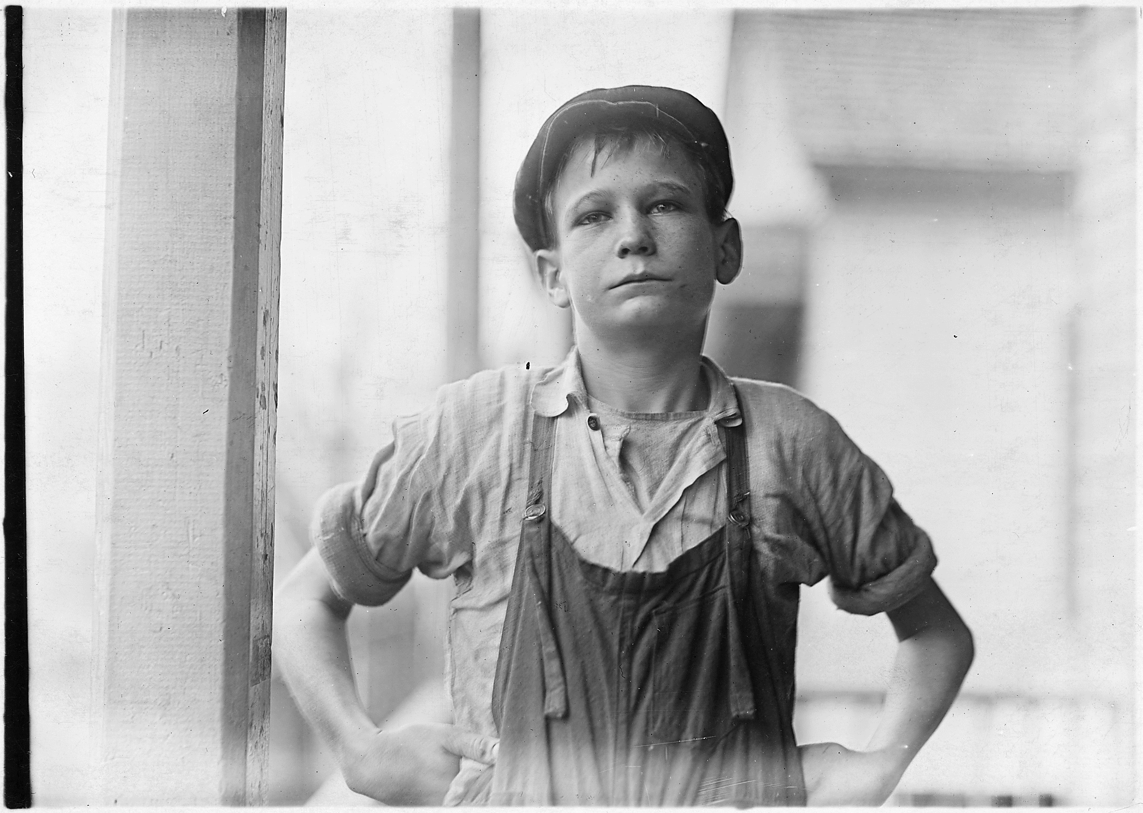
3. Change The Way You Look At The Situation
If you have a nagging issue that won't go away, instead of caving into your bad attitude, try to find a different way to think of the situation. After all, reality is what we construct, so the way we respond to an experience is the way we end up feeling.
Thambipillay pointed out, "For example, if you feel like you have too much to do at work, rather than complaining and wishing it will go away, take on your extra work as a challenge. Imagine how good it would feel to get through all this work and have your head above water again. Then, with your new positive attitude attack your workload with a new enthusiastic gusto." Find different ways to approach negative experiences and you can come out with a more positive attitude.

Slide 6

4. Think Of How Your Life Will Change If Your Attitude Changes
If you're having a hard time finding a reason to shake off your bad attitude, think ahead how a change in attitude will change and better your life. There's your motivation right there.
Heisman asked, "Will changing your attitude mean a happier family or social life? Will a change in your attitude mean a more successful career or business? Fix your mind on the things that would come as a result of your attitude change and you will have a greater chance of reaching your goal." When you realize how much better your situation could be if only you tweak your outlook on things, you'll see the value of working through your bad attitude.

Slide 7

5. Take Stock Of What's Amazing In Your Life
When we're stuck in a bad attitude, it can be hard to see the way out. If work sucks, then everything else does. Your boss makes you feel like you don't bring value, your cash flow makes you think you don't have enough to enjoy a Saturday night, and your mindless tasks make you feel like you're wasting your life. Yes, these are all terrible things. But they're not the only things in your life, are they?
Thambipillay suggested, "Every day, look for things to be grateful for. I don’t care how tough things get, there is always something to be grateful for." When you're feeling particularly dark, be corny and make a list of everything you truly feel #blessed over. It'll put things into perspective and make you realize this isn't all there is to your life.

Slide 8

6. Start Using More Positive Speech
If you want to change your bad attitude, change your negative speech. Instead of thinking that you can't finish something in time, change it to "I can finish this portion of the project on time." Or if you're feeling particularly lonely and unwanted, change "No one wants to hang out with me," to "I have so much time to work on passion projects." And it's true — these are just different ways of looking at the situation and will have your brain going in a more positive direction.
Health coach David Zulberg at self-development site Mind Body Green says, "Use statements like, 'I am hopeful,' or, 'We will find a resolution,' throughout the day. The words you use when you talk have a major impact on your attitude and emotional outlook." Words construct our reality, so choose to make them positive.

Slide 9
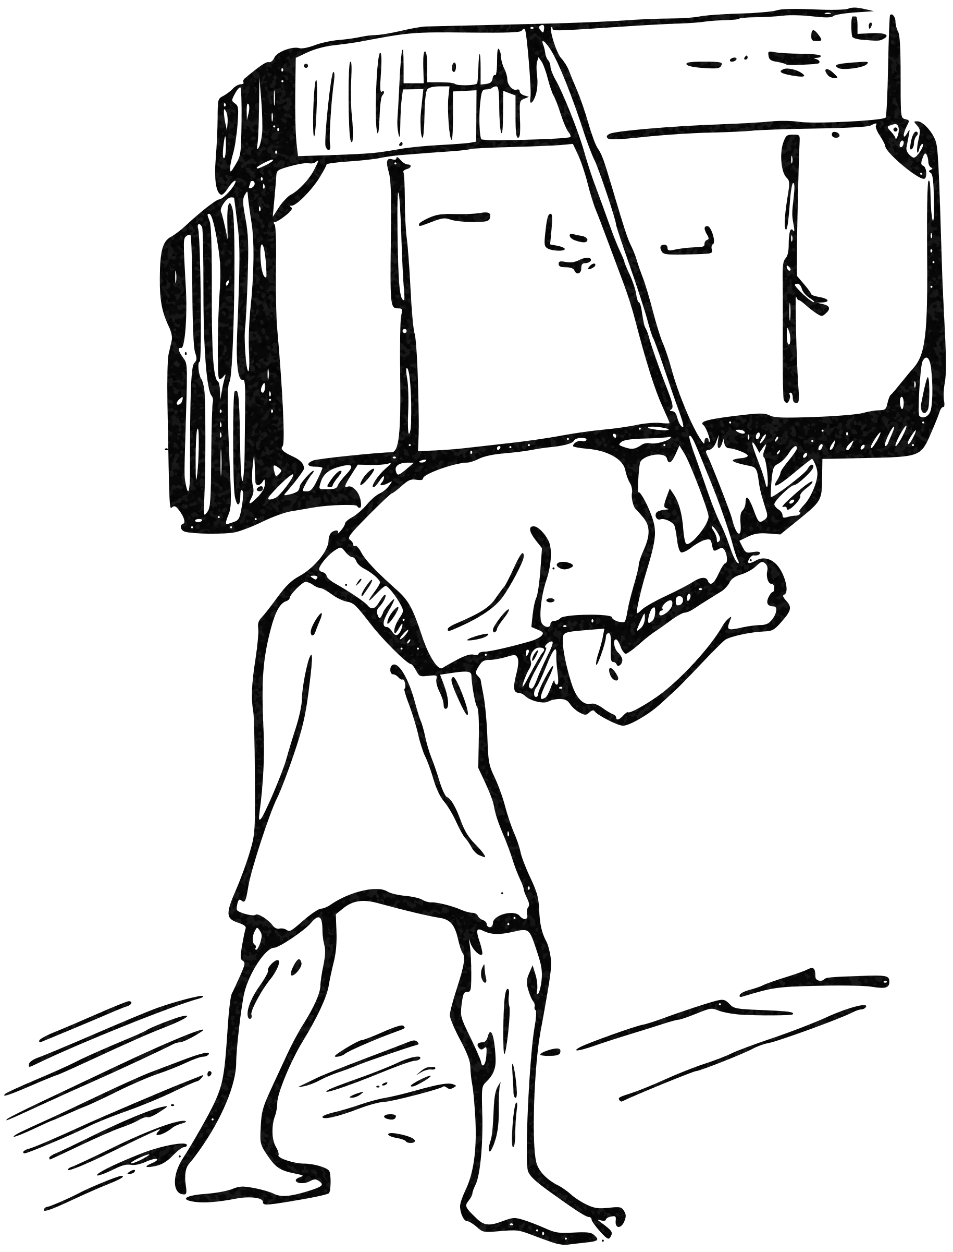
7. Steer Clear Of The Victim Mentality
Don't turn yourself into a victim: If you constantly think that things are happening to you, you're taking responsibility out of your hands and folding. This only stunts your ability to change something negative into positive. Remember, nothing is ever out of your hands; you are responsible for your own thoughts and how you handle a situation.
According to self-improvement writer Chris Talambas at Life Hack, "We have unlimited potential within to create our own reality, change our life, and change our thoughts. When we begin to really internalize this, we discover that no one can make us feel or do anything. We choose our emotional and behavioral response to people and circumstances."

Slide 10
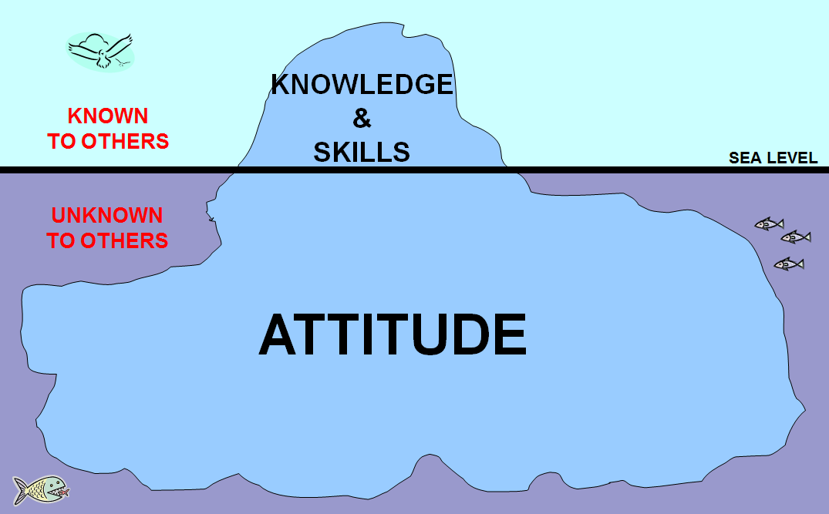
If you want to improve your bad attitude, realize that nothing is happening to you. You have the power to change it around.

